Slide 1


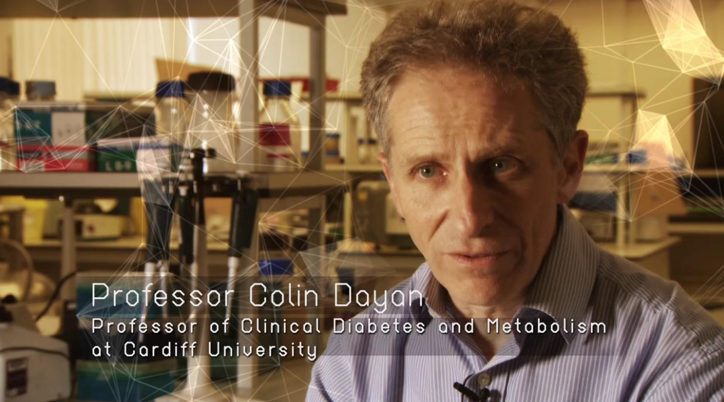
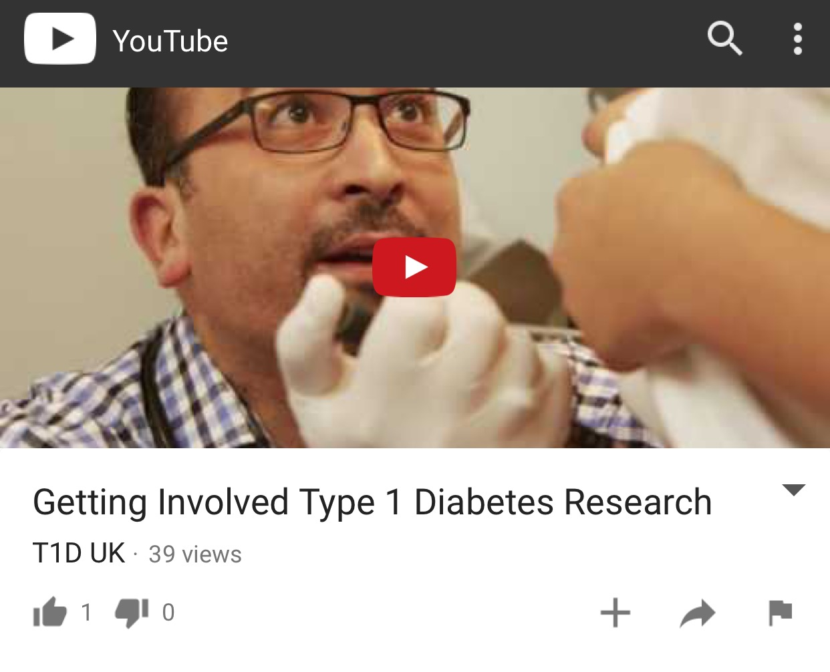
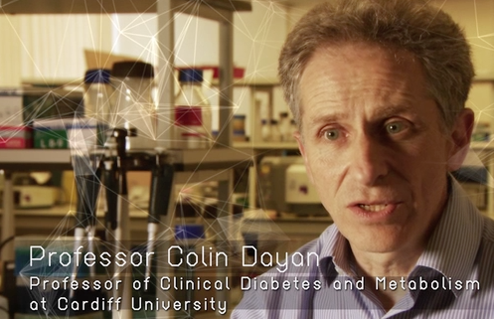
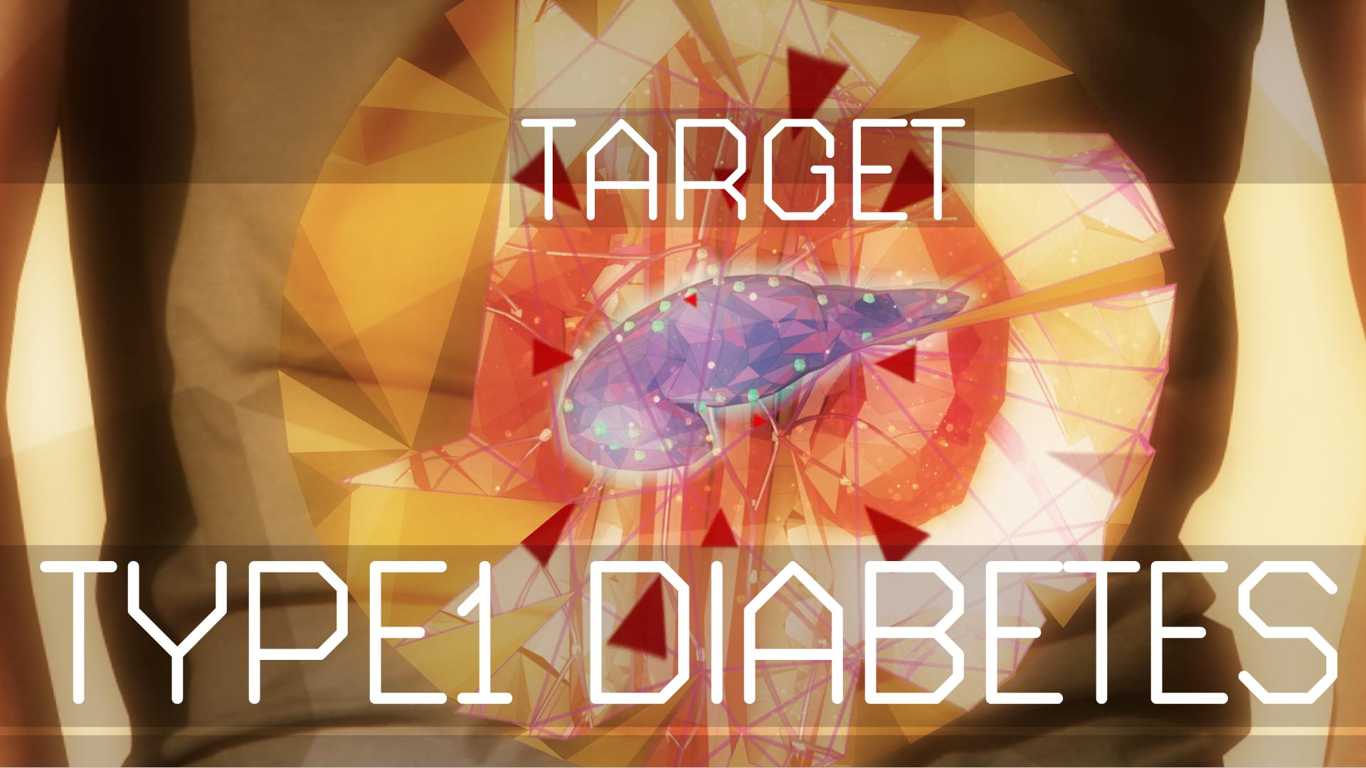
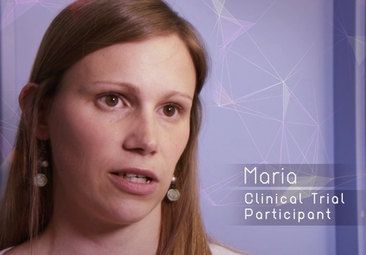
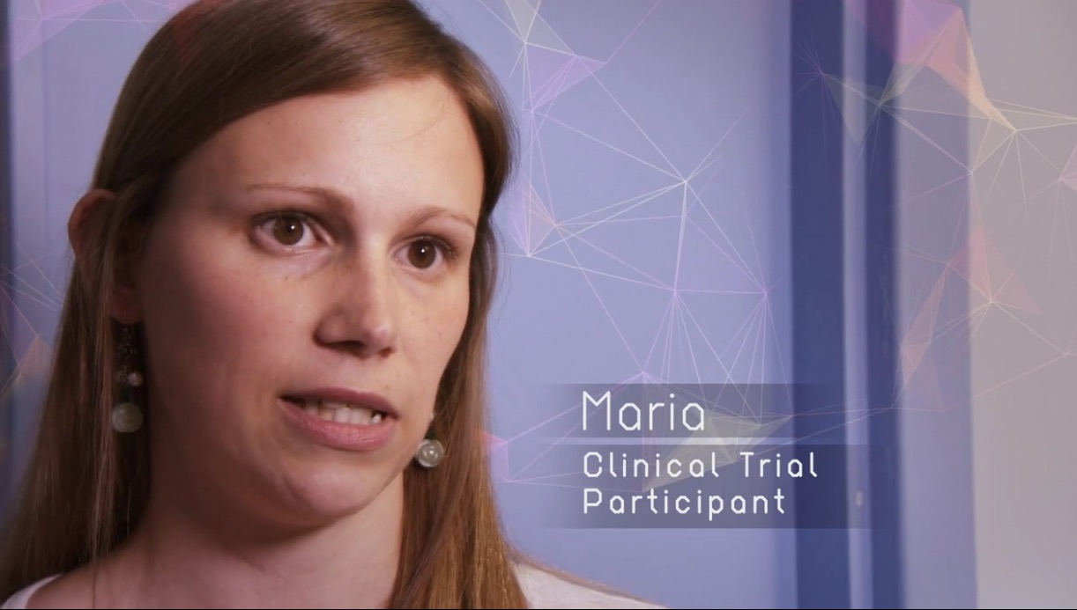




Use of a “YouTube” style video clip to raise interest amongst young people with new-onset T1D in immunotherapy trials
M Alhadj Ali^{1,2}, J Bowen-Morris², N Tze Gee³, R Stenson^{1,2}, H Walkey^{2,4}, K Littlemore⁵, C Dayan^{1,2}
¹Cardiff University School of Medicine, Cardiff University School of Medicine, Cardiff, UK
² Type 1 Diabetes UK Consortium, UK
³ Cardiff University School of Medicine, Cardiff, UK
⁴ Department of Medicine, Imperial College London, London, UK
⁵ eHealth Digital Media Ltd, UK
Introduction
Figure 1: Results of parents and patients voting on:
Type 1 Diabetes (T1D) is a chronic autoimmune disease that requires the development and application of a new generation of novel approaches focused on autoimmunity. These studies aim to reach a better understanding of pathogenesis.
Current recruitment strategies of young people with new-onset T1D into immunointervention trials have been disappointing with < 5% of eligible T1D patients entering these trials.
YouTube video that showed me what will happen would make it more likely I would take part
Video clips of young people talking about what happened to them in the study would make it more likely I would take part
A
B
Aims and objectives
Young people frequently receive information through video from sites such as “YouTube”.
We aimed to explore patient interest in short videos on trials of T1D immunotherapy and develop a prototype for use in the UK.
Figure 2: YouTube video clip (Getting Involved Type 1 Diabetes Research)
Barriers to recruitment were explored via a survey of trial sites, patient advice panels and a Patient and Public Involvement event using electronic voting held in collaboration with the JDRF.
The feedback was used to design and commission a video for internet release and use in clinics.
Methods
Results
High proportions of patients and parents reported they would be more likely to take part in research if they could watch a “YouTube” video showing what would happen if they or their child took part (80%) (Figure 1A), and if they could watch clips of young people talking about their experiences of taking part in research (82.5%) (Figure 1B).
A short video (“Getting Involved”) of 3:41 minutes was developed based on the feedback which included: patient interviews, young people’s voices, computer-digital graphics of the pathophysiology of T1D (Figure 2).
Conclusions
Providing video-based information appears to be more relevant to young people helping them to make an informed choice about whether to participate in a clinical trial.
An assessment of impact on recruitment is required, and feedback to inform the development of other materials aiming to boost recruitment.
Scan me
Link to video
This work was supported and funded by Diabetes UK and Type 1 Diabetes UK Consortium
Notes:
Notes on the templates – try to keep font to Arial throughout for consistency. Do not change the dark blue colour and light blue background. Bullet points are circles and the same colour as the dark blue. Every poster is different so the actual layout will differ for every poster.
Dark blue
RGB: 0, 51, 204
Light blue
RGB: 204, 236, 255

